Slide 1


Highlight Removal Based on Muti-frame Matching and Stitching
MSC Practicum Report
Presentation : You Sicheng
SSOID: 22406085
May 18 2023

Slide 2
CATALOG
01
02
03
04
Background
Basic Theory
Algorithm
Evaluation

Slide 3
CATALOG
05
06
Potential Application
QA

Slide 4
PART 01
Background

Slide 5
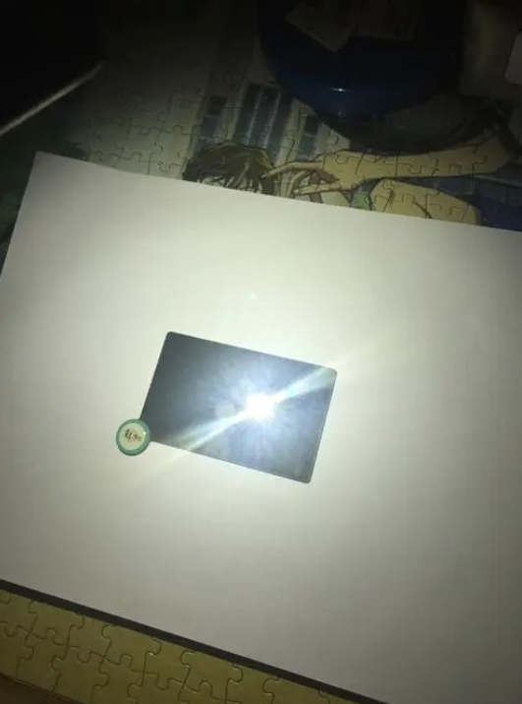
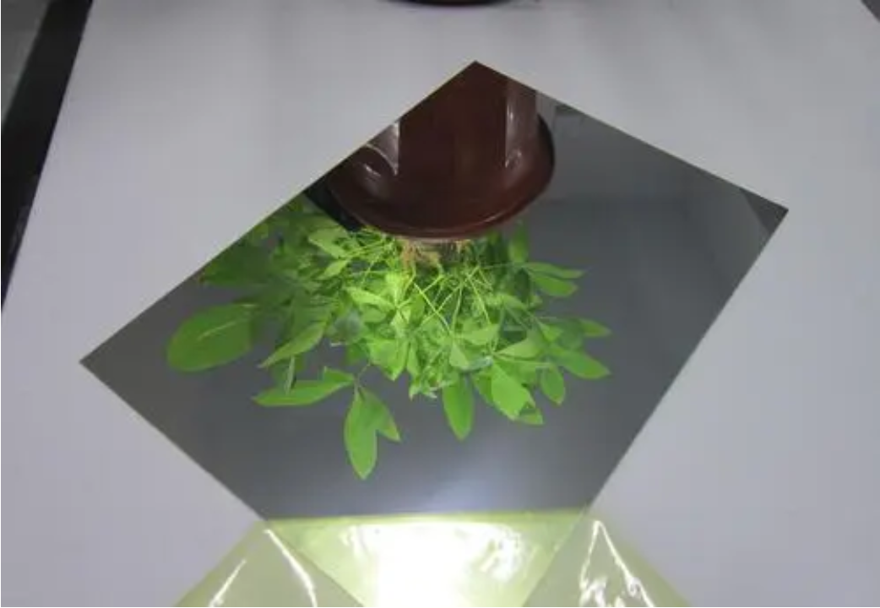
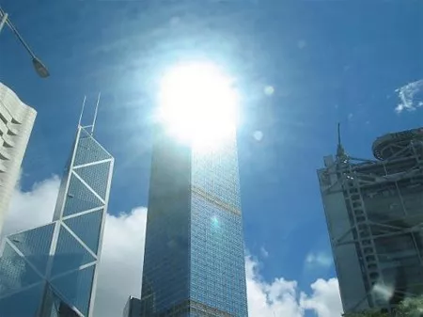
Highlight in Nature
流程说明-1
Highlight may cause by mirror reflection or gathering of light.
Highlight can cover up some detail of images which may make images lose important components.
流程明-2
流程说明-3
流程说明-4

Slide 6
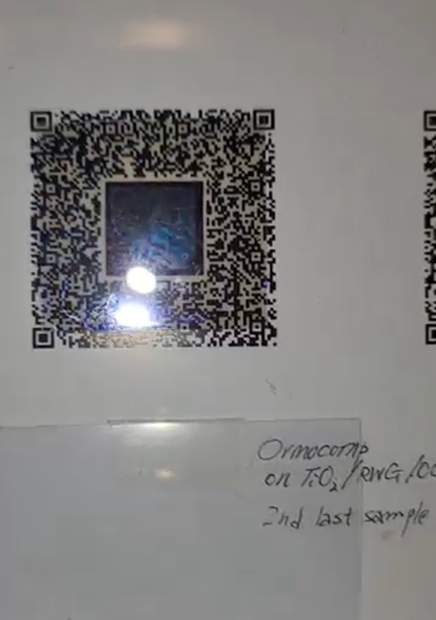
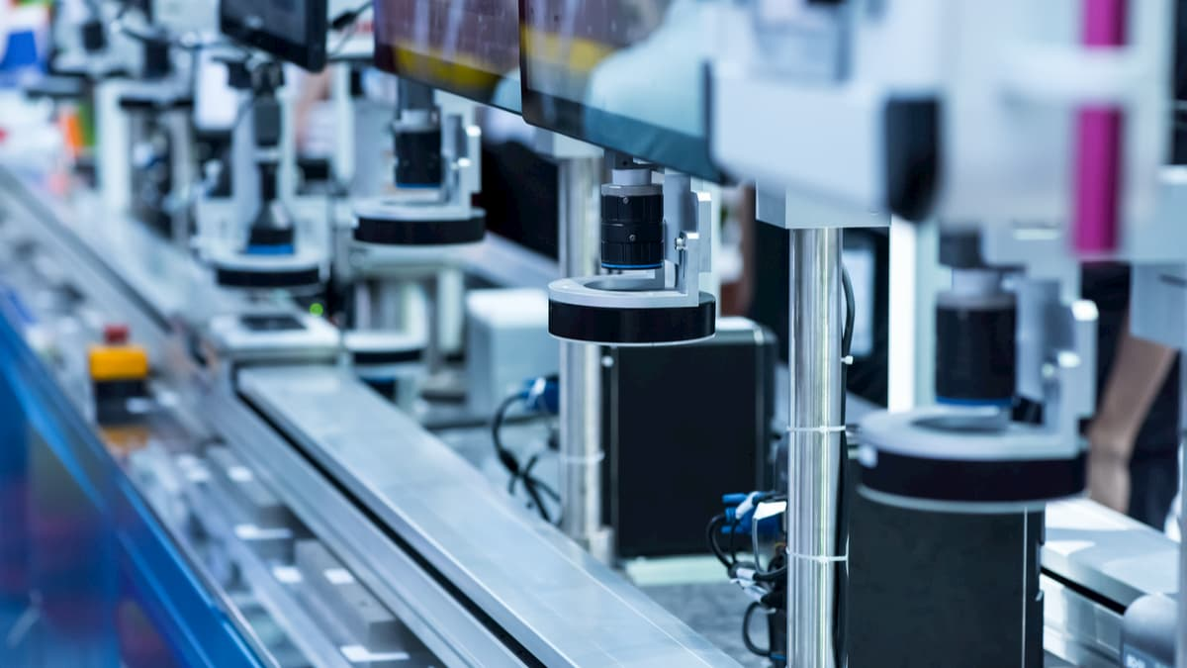
Highlight on QR code
An industrial QR code has an inner code and an outer code, which represent different information.
An industrial QR code is attached to the surface of product to show its detailed information. When a camera scans the QR code, its information can be read.
流程说明-1
流程明-2
流程说明-3
流程说明-4
Due to complex light environment in factory, highlight may be on the QR code.

Slide 7

How to remove highlight in QR code?
Manually Repair
Deep Learning
01
Can not restore center of highlight.
03
Image Augmentation
Image Stitching
02
Can not restore center of highlight.
Restore center of highlight.
04

Slide 8
PART 02
Basic Theory

Slide 9
Highlight Removal by Stitching
Goal: remove highlight and restore detail of QR code.
How to use algorithms in traditional computer vision to solve?
Find the position of highlight and the position of QR code.
Based on the position and distance to find the first keyframe.
Based on feature points matching to find second keyframes.
Stitch two frames.
Augmentation for inner QR code.
流程说明-1
流程明-2
流程说明-3
流程说明-4

Slide 10
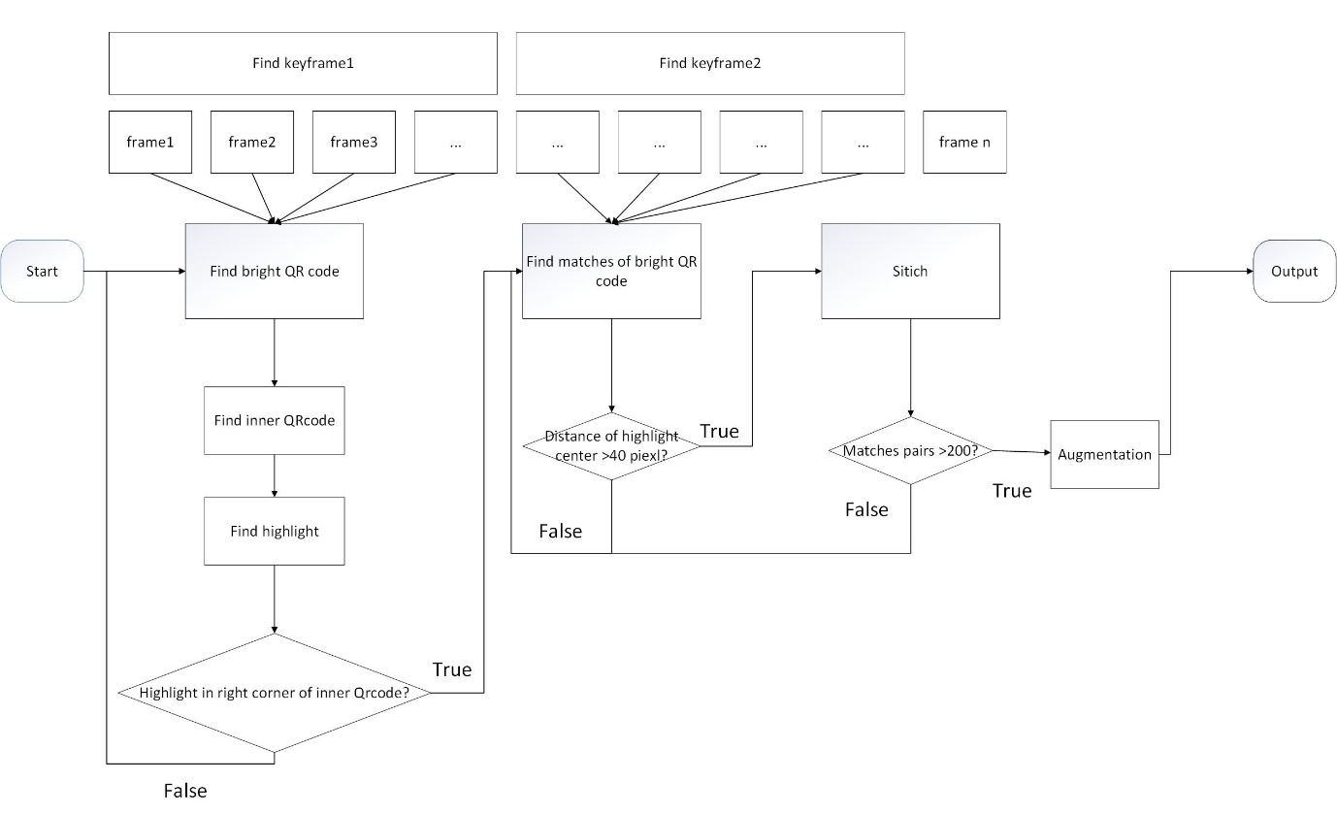
Algorithm Framework
流程说明-1
流程明-2
流程说明-3
流程说明-4

Slide 11
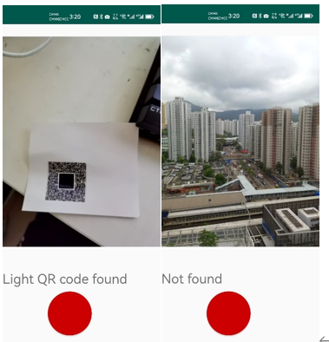
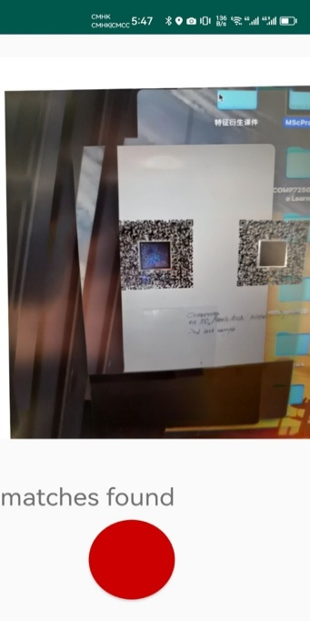
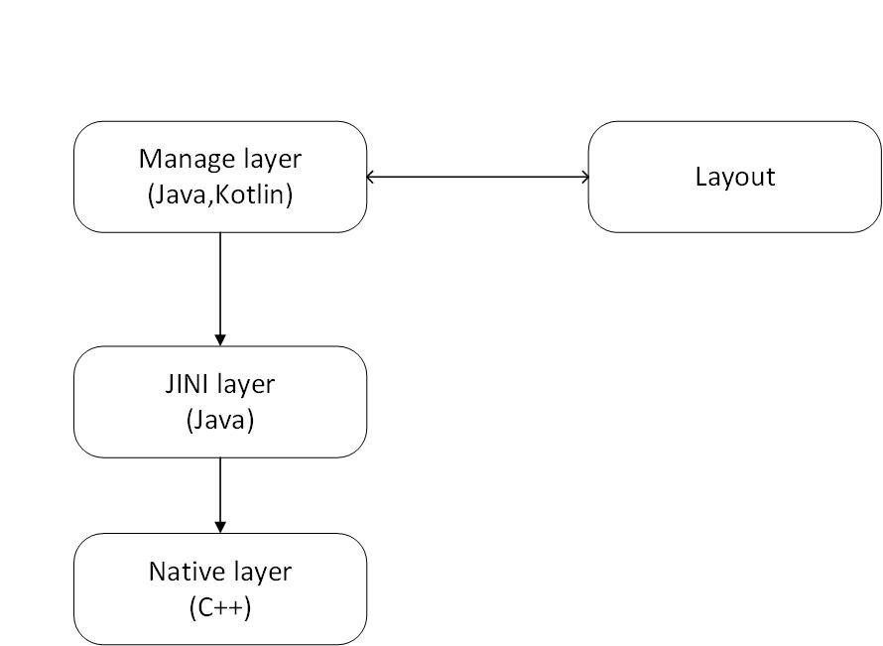
Algorithms Transplant in Android
The project will also attempt to transplant the algorithm in Android to fulfill special scenarios in applications.
流程说明-1
流程明-2
流程说明-3
流程说明-4

Slide 12
PART 03
Algorithm

Slide 13
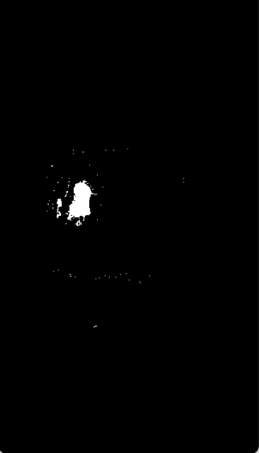
Edge Recognition
Binarization:
Setting a threshold.
Split pixels by the threshold.
Why using binarization to extract edge of highlight?
Pixels values of highlight are extremely high than other pixels. Highlight can be recognized by pixel values easily.
流程说明-1
流程明-2
流程说明-3
流程说明-4

Slide 14
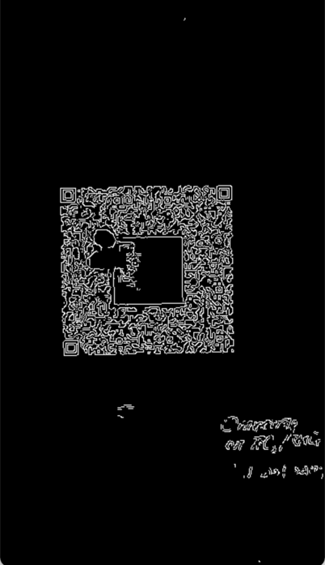
Edge Recognition
Canny:
Gaussian filtering :reduce noise.
Sobel :convert pixel values to gradients.
Non-maximum suppression: optimization for gradients computation.
Double threshold: reduce false positive of edges.
Why using Canny to extract edge of QR code?
Color feature of inner QR code and outer QR code are the same.
Binarization is not suitable to find this edge. However, there are gaps between inner QR code and outer QR code. A gap has a higher gradient than other area in an image.
流程说明-1
流程明-2
流程说明-3
流程说明-4

Slide 15
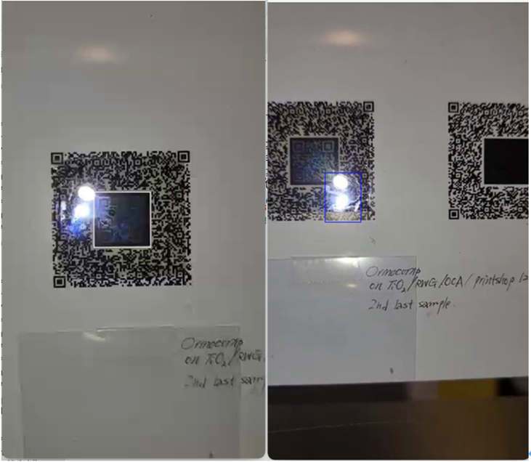
Keyframes Selection
The first keyframe is a frame with a light in the right bottom corner of the inner boundary of the QR code.
The second keyframe is a frame with a light far away from the right bottom corner of the inner code.
流程说明-1
流程明-2
流程说明-3
流程说明-4

Slide 16
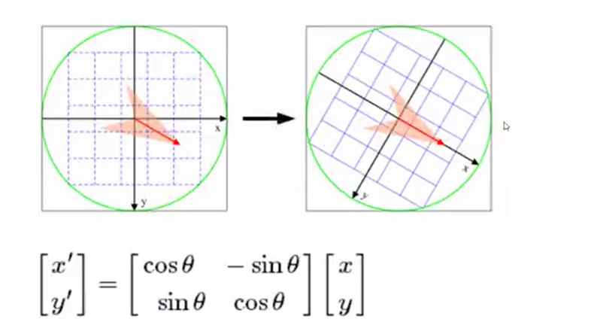
Feature points
SIFT:
Gaussian function: convert pixel values to probability distribution.
Down sampling: reduce size of image.
Difference of Gaussian: use it to find extremums by derivation
Extract BRIEF: Calculate direction and module of extremums.
流程说明-1
流程明-2
流程说明-3
流程说明-4

Slide 17
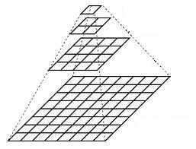
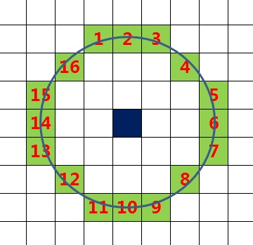
Feature points
ORB:
Find FAST feature: centered on a point, use a radius to find its neighbors. If there are enough neighbors are in range of a threshold, it is ORB feature point.
Grayscale centroid: make ORB stay unchanged when rotating.
Image pyramid: make ORB stay unchanged when zooming.
Extract BRIEF.
流程说明-1
流程明-2
流程说明-3
流程说明-4

Slide 18
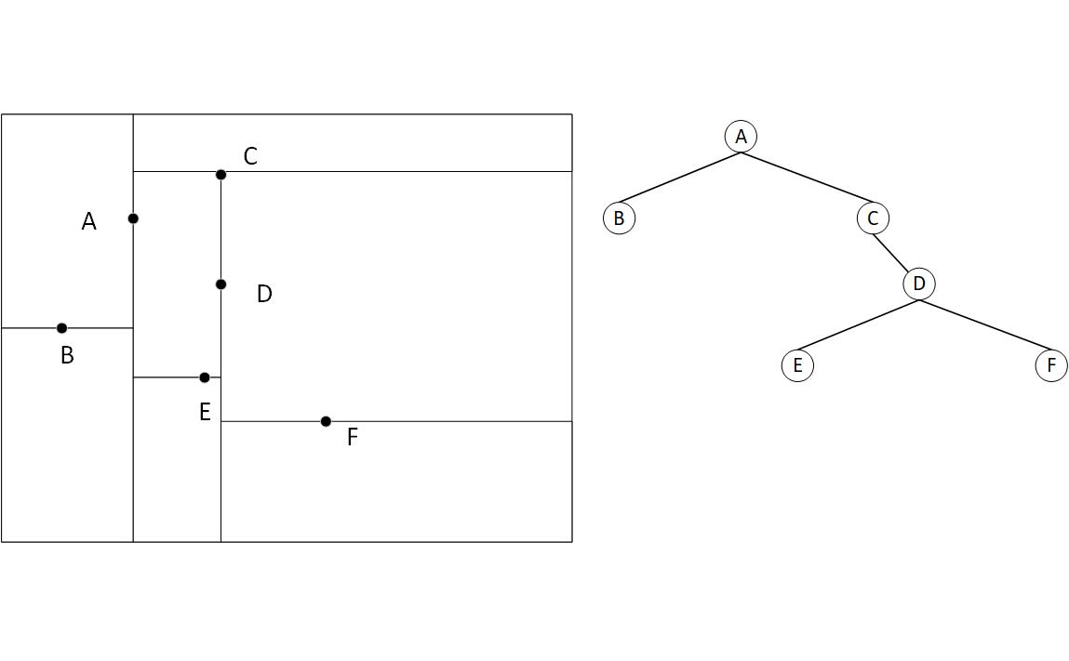
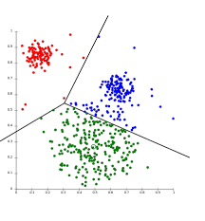
Feature points matching
FLANN :
FLANN randomly constructs many k-d Tree, which splits an image into many blocks based on two dimensional binary search.
Searches the tree nodes to match each BRIEF.
流程说明-1
流程明-2
流程说明-3
流程说明-4
K-means
K-d Tree

Slide 19
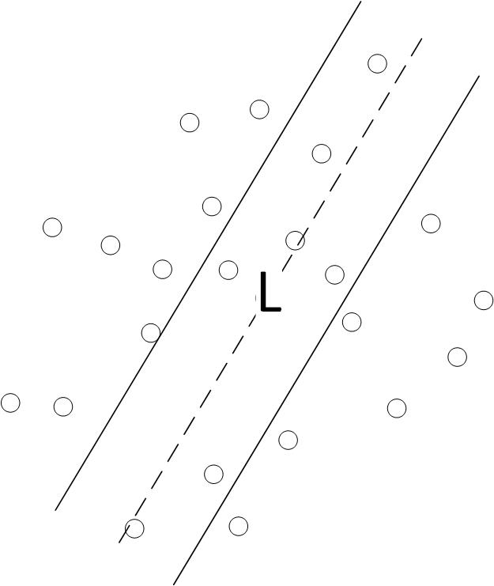
Frame Align and Transformation
RANSAC:
RANSAC calibrates two axes in a space to a same one.
Inliers: the same feature points existing in two images.
RANSAC selects part of feature points randomly. Calculate a line passing these points.
If there are enough points in the line, these feature points are inliers.
Use inliers pairs to solve homography.
流程说明-1
流程明-2
流程说明-3
流程说明-4

Slide 20
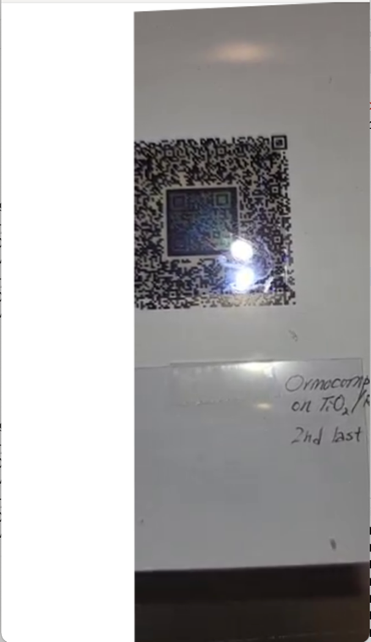
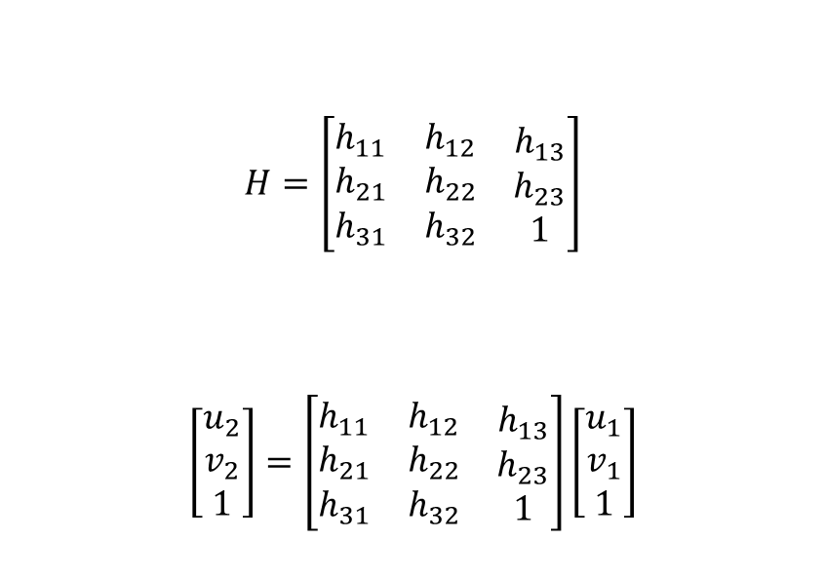
Frame Align and Transformation
Homography :
Homography is the transformation from one axis to another.
Homography uses homogeneous coordinates.
The goal is to find homography to align two frames,
$$H=\left[\begin{matrix}\begin{matrix}h_{11} \\ h_{21} \\ h_{31}\end{matrix} & \begin{matrix}h_{12} \\ h_{22} \\ h_{32}\end{matrix} & \begin{matrix}h_{13} \\ h_{23} \\ 1\end{matrix}\end{matrix}\right]$$
$$\left[\begin{matrix}u_{2} \\ v_{2} \\ 1\end{matrix}\right]=\left[\begin{matrix}\begin{matrix}h_{11} \\ h_{21} \\ h_{31}\end{matrix} & \begin{matrix}h_{12} \\ h_{22} \\ h_{32}\end{matrix} & \begin{matrix}h_{13} \\ h_{23} \\ 1\end{matrix}\end{matrix}\right]\left[\begin{matrix}u_{1} \\ v_{1} \\ 1\end{matrix}\right]$$
流程说明-1
流程明-2
流程说明-3
流程说明-4

Slide 21
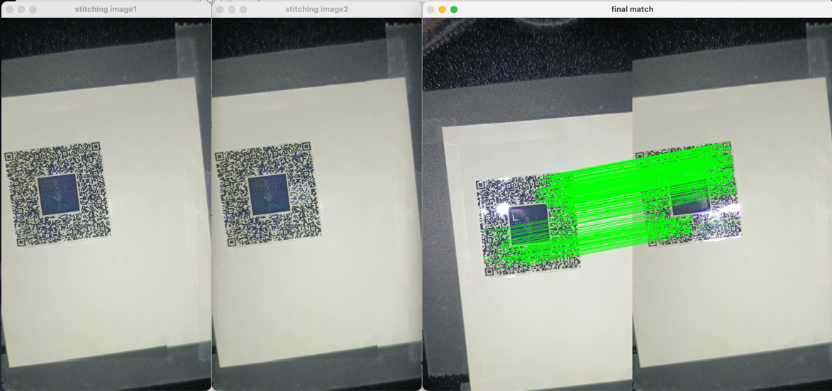
Keyframes Stitching
Min pixel comparison:
Keep pixels with min pixel values in two images.
High pixel(highlight) will be removed.
流程说明-1
流程明-2
流程说明-3
流程说明-4

Slide 22
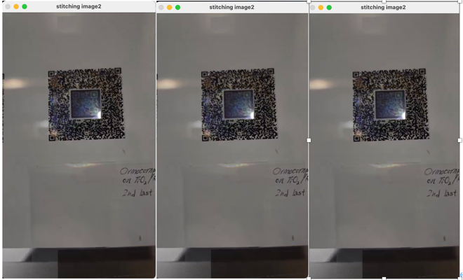
Augmentation for QR code
Filtering:
In this scenario, noise distributes in corner of QR code.
Mean filtering
Median filtering
Gaussian filtering
Filtering can eliminate noise.
流程说明-1
流程明-2
流程说明-3
流程说明-4
Median filter, Mean filter, Gaussian filter from Left to Right

Slide 23
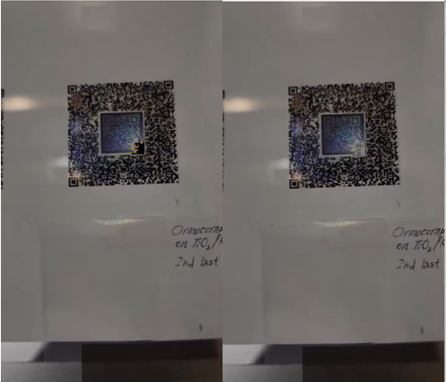
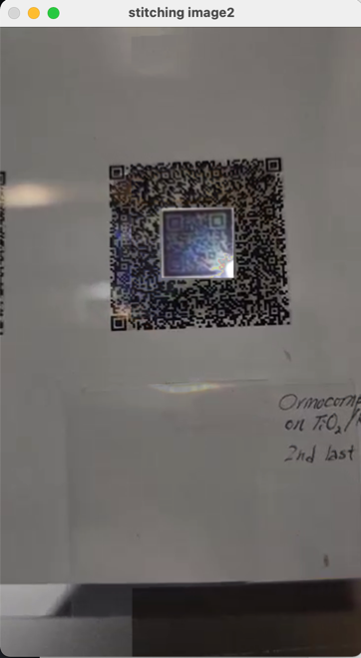
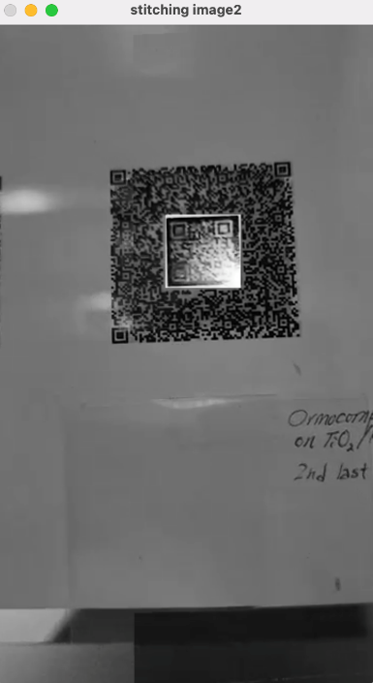
Augmentation for QR code
Other augmentation algorithms:
Pixels inhibition
Pixels inhibition with Gaussian filtering
Histogram equalization
流程说明-1
流程明-2
流程说明-3
流程说明-4

Slide 24
Algorithms Transplant in Android
NDK is a cross-platform tool, which allows developers to use C++ in Android.
Manage layers includes activities and layout of Android applications. Jini layers have interfaces of functions of C++. And native layers have C++ codes. As for the project, only two algorithm entrances will be exposed in Jini layer.
流程说明-1
流程明-2
流程说明-3
流程说明-4

Slide 25
PART 04
Evaluation

Slide 26
Analytics for Time Complexity
If two keyframes both exist in a video stream, the time complexity is the frame numbers of second keyframe. The time complexity is all the frame numbers for the worst scenario.
However, if the first keyframe and the second keyframe can not be found in all frames, stitching will be unsuccessful.
流程说明-1
流程明-2
流程说明-3
流程说明-4

Slide 27
Comparation between stitching and deep learning
Highlight removal by stitching:
The project has an advantage than highlight removal by deep learning. Highlight removal based on stitching perfectly restores the original background of the highlight area instead of using special neural networks like GAN to restore the background. It is exactly the same as the original background.
Highlight removal by DL:
流程说明-1
Unable to predict background hidden by highlight.

Slide 28
Improvement
Tuning experience values
Ratio between width and height of QR code.
Upper bound values of binarization for highlight.
The area between the lower right corner and highlight.
The number of matches pairs.
流程说明-1
流程明-2
流程说明-3
流程说明-4

Slide 29
PART 05
Potential Application

Slide 30




Application for highlight removal
Highlight removal for
bar code recognition
Highlight removal for
face recognition
Highlight removal for
QR code recognition
Highlight removal for
document recognition

Slide 31
PART 06
Q&A

Slide 32
Highlight Removal Based on Muti-frame Matching and Stitching
MSC Practicum Report
Presentation : You Sicheng
SSOID: 22406085
May 18 2023

